Slide 1
Advanced Programming in Python By Government of Pakistan National Vocational and Technical Training Commission (NAVTTC) Prime Minister’s Hunarmand Pakistan Program ‘Skills For All’
Instructor
Engr. Imran Khan
Program Head
Prof. Dr. Sheeraz Ahmed
Iqra National University Peshawar

Slide 2
Content
What is NAVTTC
What is Kamyab Jawan Program
Faculty involved
Course Objectives
Motivation
Why Should we learn Python?
Curriculum to be covered

Slide 3
NAVTTC
Government of Pakistan’s organization for National Vocational and Technical Training Commission
It’s jobs are:
National Policies, Strategies, and Regulation
Designing & Implementing Skill Training Programs to bridge the demand-supply gap
Industry 4.0 and Education 4.0 Skills
Accreditation, Certification, Skill Standards & Curricula
Performance Evaluation System
TVET Development through Public-Private Partnership
Labor Market Information System

Slide 4
Kamyab Jawan Program
National Youth Development Program
FREE 6 months skill development courses
Providing Technical training to youth
Two categories of trainings
Traditional Trades
High-tech & Emerging Technology Trades
High-tech trades includes
Advanced Programming in Python, Cloud Computing, Web & Application Development, Artificial intelligence etc.
Enabling youth to increase their income by jobs, free lancing & entrepreneurship

Slide 5
Faculty Involved in Trainings
Instructor
Engr. Imran Khan
Data Engineer and Machine Learning Specialist
(Contact for any queries/ issues related to training)
imrancaan@outlook.com
Program Head
Prof. Dr. Sheeraz Ahmed
(Faculty/ Researcher/ Dir. ORIC, Iqra National University)
03018909730
Program Coordinator
Dr. Mohsin Tahir
(Faculty/ Researcher/ Dir. QEC, Iqra National University)
03459126680

Slide 6
Course / Training Objectives
Course designed to address unemployment in the youth
Specially designed practical tasks to be performed by the trainees
Not just theoretical understanding but aimed at equipping the trainees to perform commercially in a market space
Learn Work Place Ethics to highlight the importance of good and positive behavior in the workplace and elsewhere
Professional Certifications (Worldwide recognized)
Not just technical knowledge but learning soft skills as well
Interpersonal/communication skills; personal grooming of the trainees etc., as well as entrepreneurial skills (i.e. marketing skills; free lancing etc.)

Slide 7
Motivation
Python is one of the most loved programming languages because of its versatility, flexibility, and object-oriented features.
Multiple Programming Paradigms
Web Testing
Data Extraction Transformation (ETL), Web Scraping and Automation.
Artificial Intelligence(AI),Machine Learning,Deep learning and Data Science Researches
Web Application and Internet Development
Database Easy Access, Interface Customization, and Quick System Integration
Cybersecurity

Slide 8
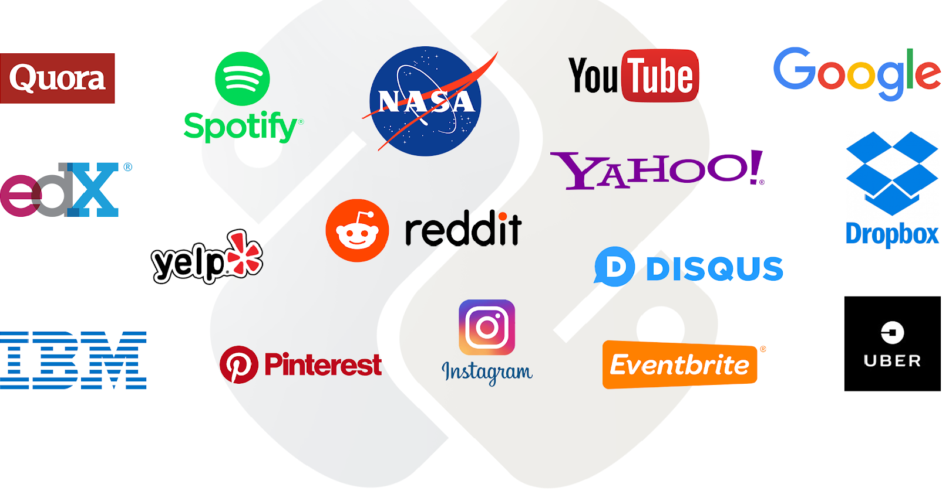
Famous corporate organizations using Python.

Slide 9
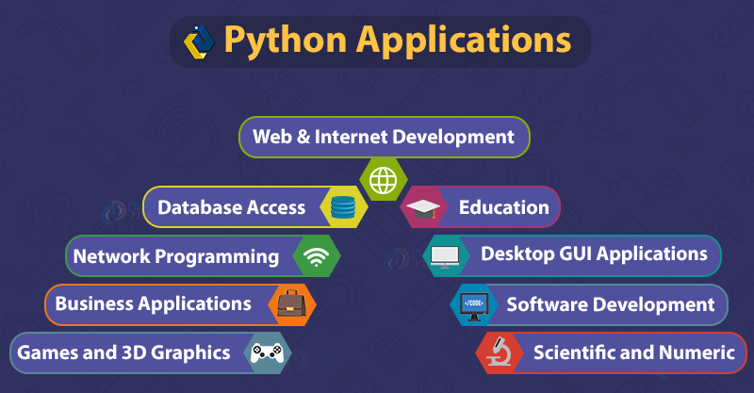

Slide 10
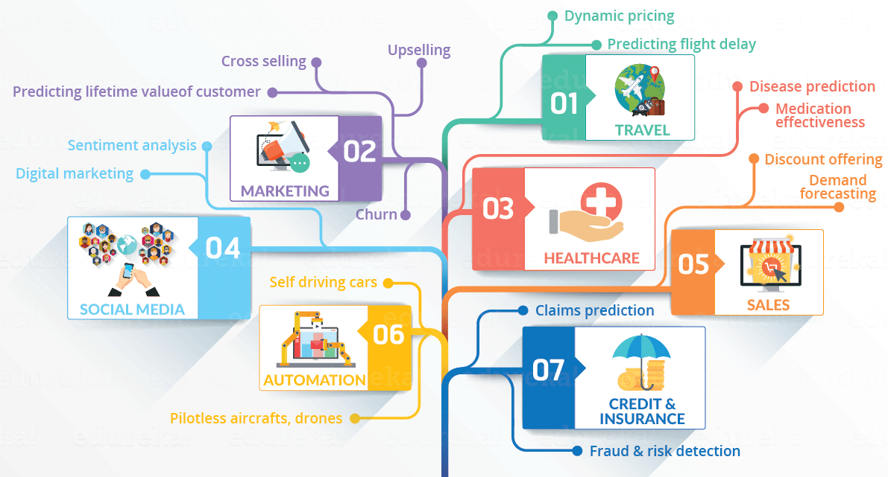
Python Application and Uses

Slide 11
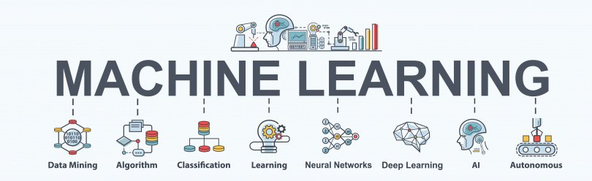
Python Applications and Uses

Slide 12
Curriculum
The curriculum covered in this training can be divided in four parts
Introduction & Learning Python Basics
Data Sciences using Python
Fundamental of Machine Learning Using Python
Learning Free Lancing, entrepreneurship & soft skills
By the end of the course the trainees will have an understanding of various industry demanding Fields
Learning for Worldwide recognized Associate Certification

Slide 13
Course breakdown
The first few weeks would be a concentration on Python basics:
Basics of Python
Syntax, loops, Decisions, data Structure, functions, OOP etc. .
Introduction to Data Sciences
Data processing, pandas, Statistical analysis, visualization and charting, etc.
Statistical Analysis
Distributions, Binomial Distribution, Uniform Distribution, Skewness, etc.
Visualization and charting.
Visualization design tools, different types of charting, Story telling through charts, etc.

Slide 14
Course breakdown
Next few weeks would be a concentration on Machine Learning
Fundamentals of Machine Learning
Supervised Machine Learning
Classification and Multi-Class Classification
Deep learning
Different algorithms and their implementation in ML
Training of different ML models
Analysing performances of ML models

Slide 15
Course breakdown
Next few weeks would be a concentration on working with text
Working with Text in Python
Introduction to Text Mining
Handling Text in Python
Basic Natural Language Processing
Classification of Text
Different NLP Classifiers
Sentiment Analysis

Slide 16
Course breakdown
In between the technical knowledge, freelancing, entrepreneurship and soft skills will also be learnt
Freelancing
Fiverr, Upwork, etc.
Entrepreneurship
Job Hunting
Resume/ CV making
Communication, team work and presentation skills
At the End of the training:
Full Fledged Industry Level project implementation
Preparation and practice for International Certification

Slide 17
I HOPE YOU LEARN A LOT & ENJOY THE TRAINING! THANK YOU ☺

